Slide 1
Latin GCSE
Component 2: Literature (30%)
Wednesday 29th March 2022

Slide 4
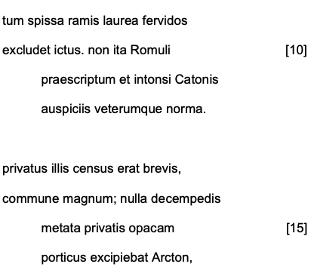
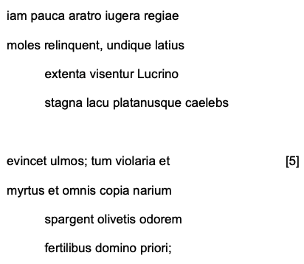
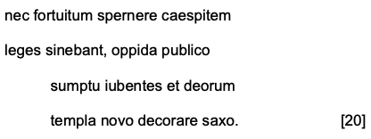

Slide 10
Questions to develop understanding
Write your answers in full sentences in your book

Slide 11
Questions to develop understanding
Write your answers in full sentences in your book

Slide 12
Questions to develop understanding
Write your answers in full sentences in your book

Slide 13
Questions to develop understanding
Write your answers in full sentences in your book

Slide 14
Questions to develop understanding
Write your answers in full sentences in your book

Slide 15
Questions to develop understanding
Write your answers in full sentences in your book

